Slide 1

What Mr. Spock would possibly say about modern unit testing: pragmatic and emotional overview

Slide 2
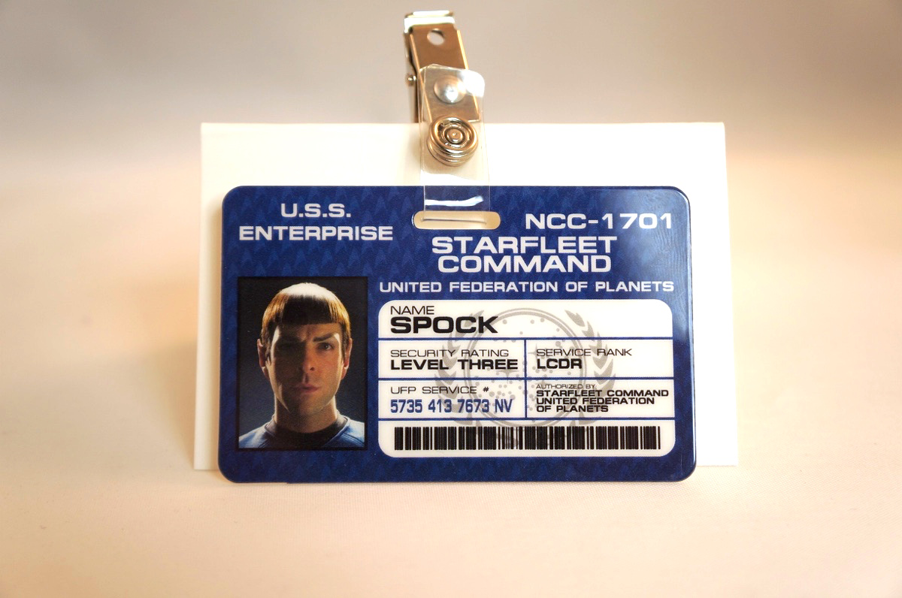
About me
Yaroslav Yermilov
Senior Software Engineer
EPAM Systems
Work on Big Data project
But responsible for test automation for
the last 2 years
Out of office is a big Groovy ecosystem fan
So the topic choice is obvious

Slide 3
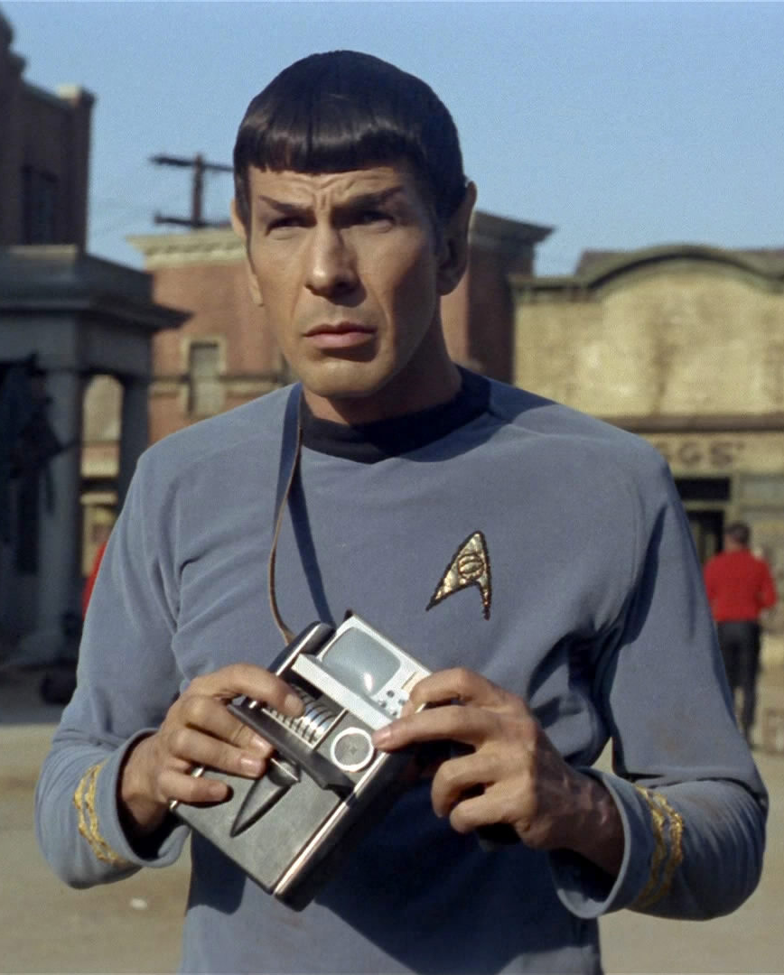
Questions Mr. Spock have
What’s about modern unit testing?
Why try Spock?
How to start with Spock?
Advanced and hidden features
What JUnit/TestNG/others offers instead?
Why use Spock?
Why do not use Spock?
When use Spock?

Slide 4




Acknowledgments and disclaimer

Slide 5

Better to test before going to production

Slide 6

JUnit?

Slide 7

JUnit 5?

Slide 8

JUnit 3?

Slide 9

TestNG?

Slide 10

Unit testing framework on steroids?
Hamcrest
AssertJ
Google Truth
Mockito
PowerMock
JMockit

Slide 11

Something odd?
Cucumber
J8Spec JGiven

Slide 12

Spock?

Slide 13

Nothing?

Slide 14
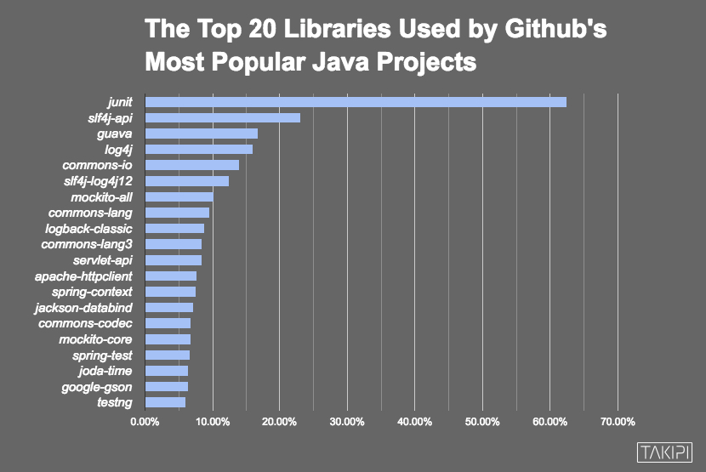

Slide 15

Automated testing
is a great concept

Slide 16

But have you ever felt like it’s frozen for the years?

Slide 17
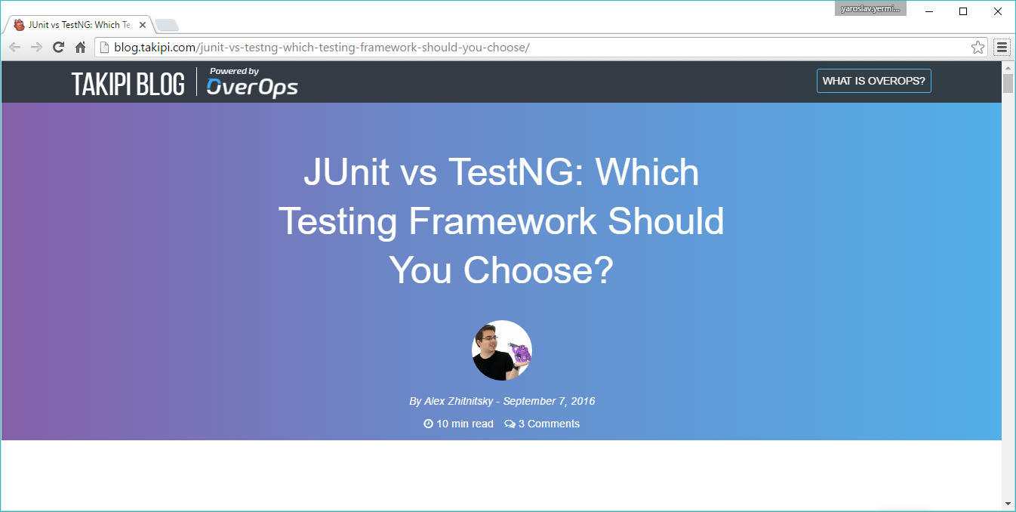

Slide 18
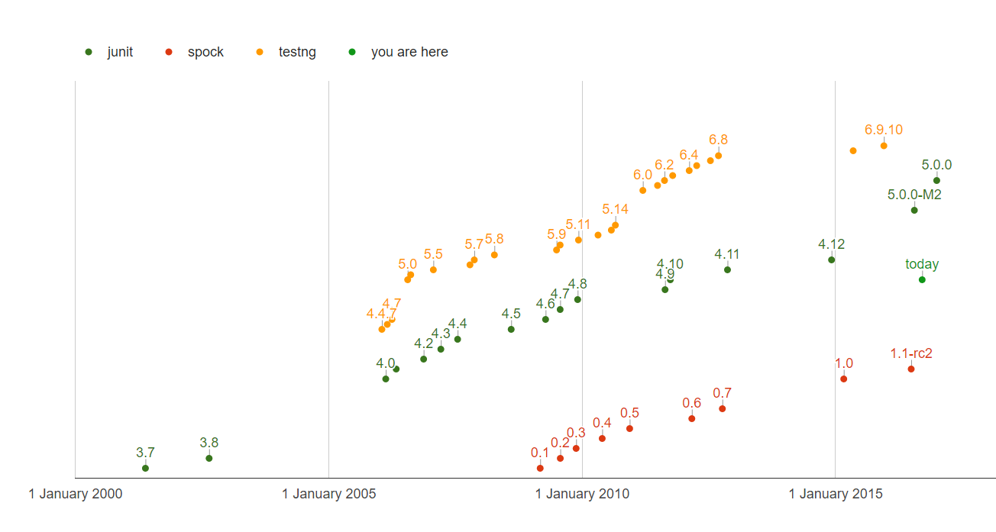
QUIZ: How many test framework releases we had since 2013?

Slide 19
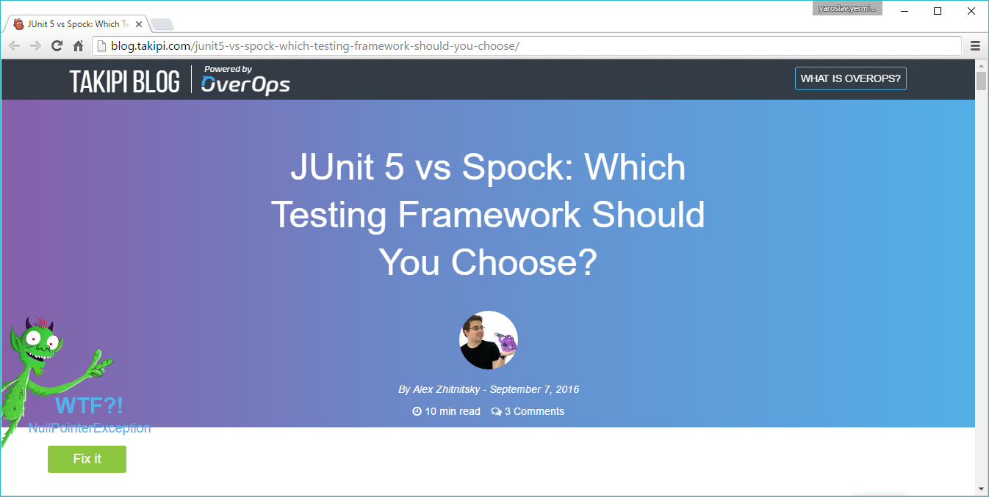

Slide 20

So why don’t try Spock?

Slide 21

Spock is the next generation testing framework

Slide 22
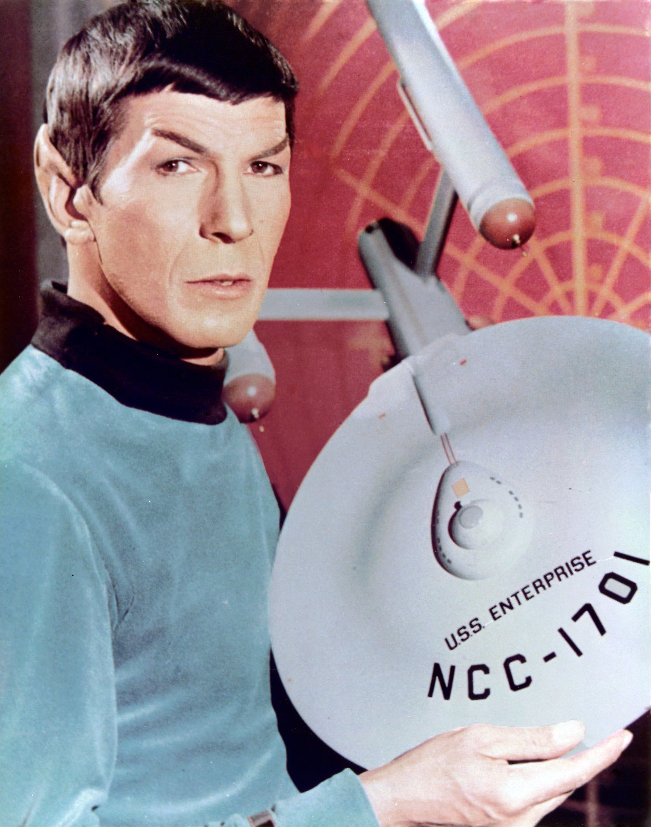
Spock is Enterprise ready

Slide 23
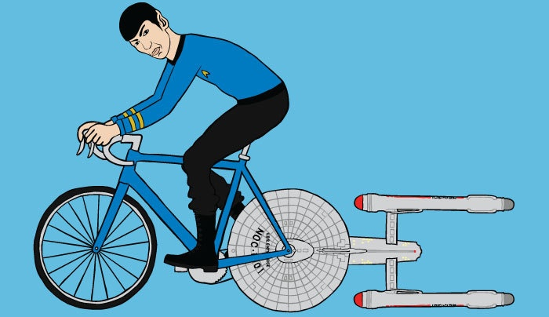
Let’s go!
https://github.com/yermilov/spock-talk

Slide 24

Episode I: Every journey starts somewhere

Slide 25
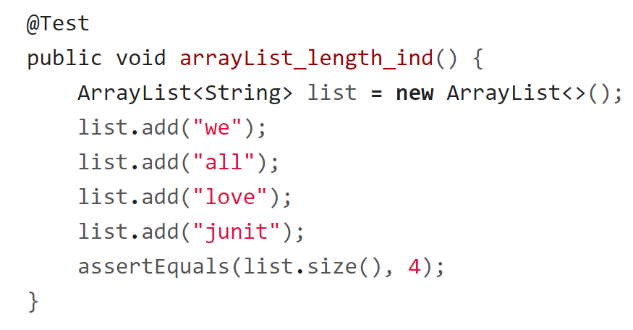
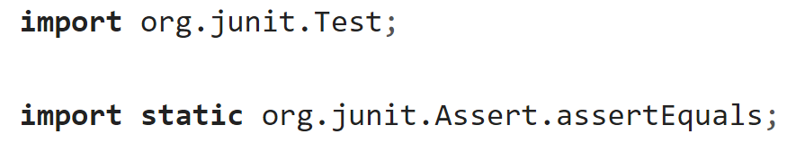
Episode I: Every journey starts somewhere

Slide 26
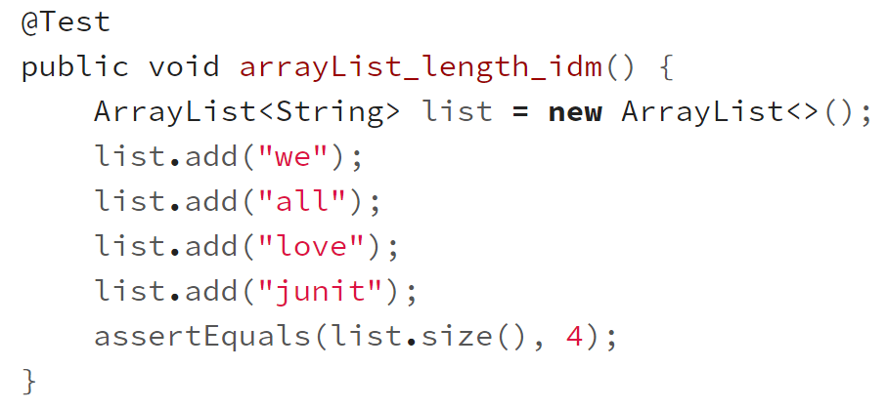
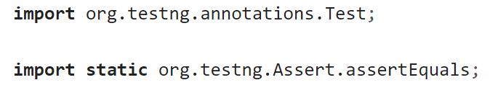
Episode I: Every journey starts somewhere

Slide 27
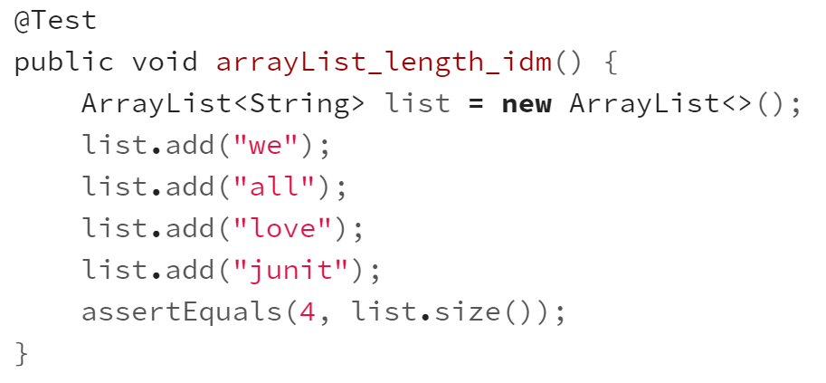
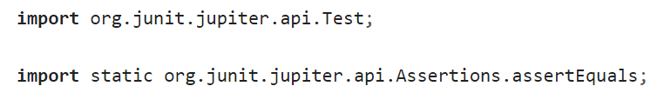
Episode I: Every journey starts somewhere

Slide 28
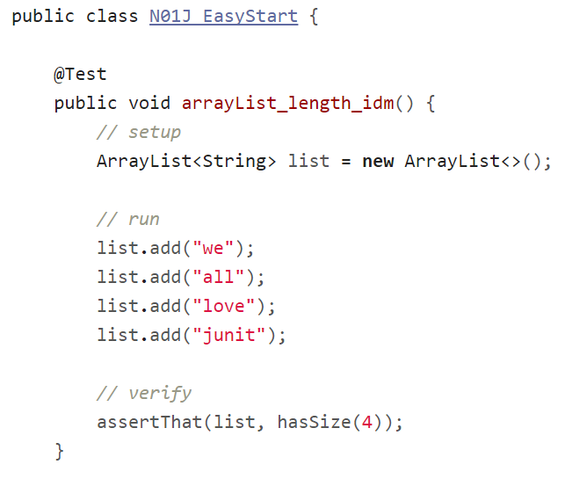
Episode I: Every journey starts somewhere

Slide 29
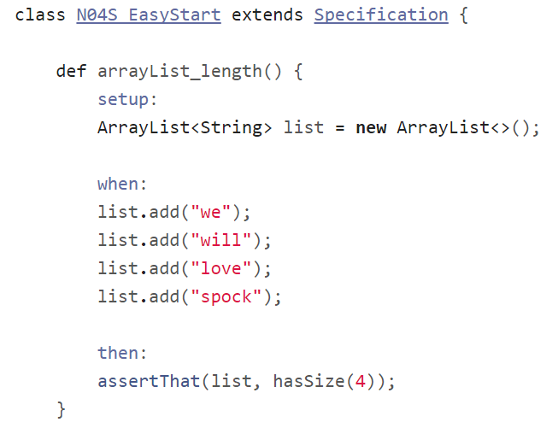
Episode I: Every journey starts somewhere

Slide 30
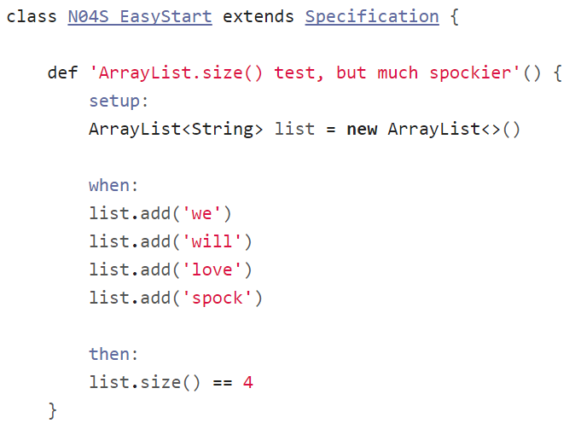
Episode I: Every journey starts somewhere

Slide 31
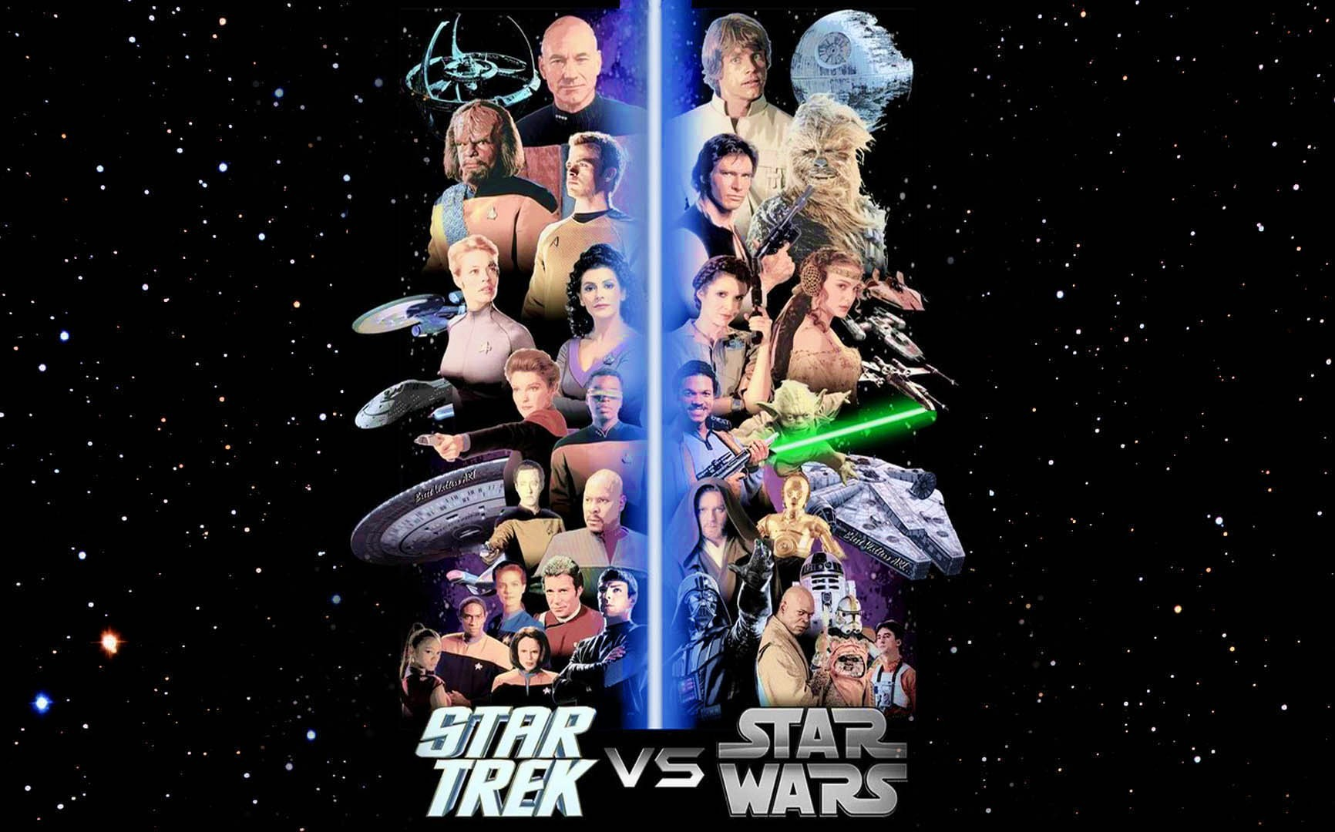
Episode II:
Assertions

Slide 32
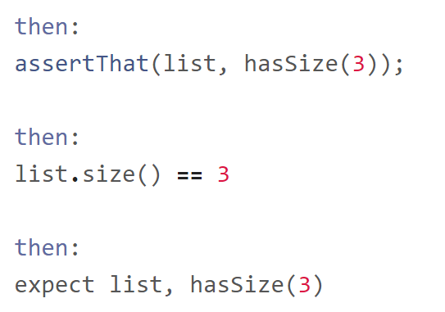
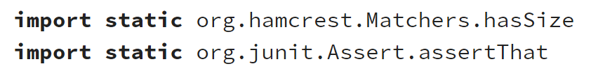
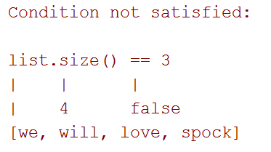
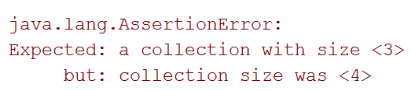
Episode II: Assertions

Slide 33
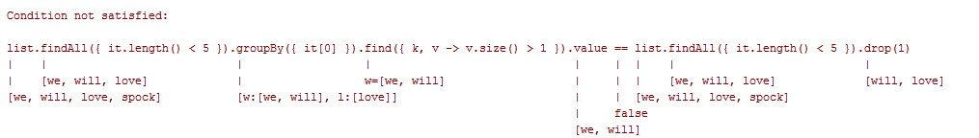
Episode II: Assertions

Slide 34
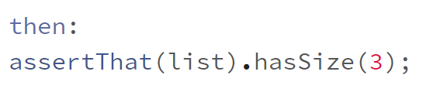
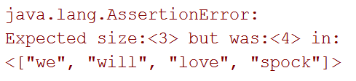
Episode II: Assertions

Slide 35
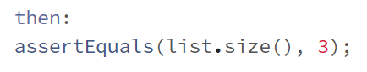
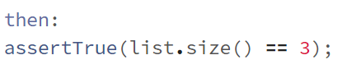
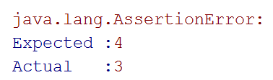
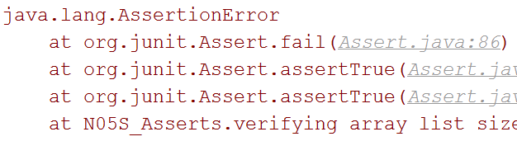
Episode II: Assertions

Slide 36
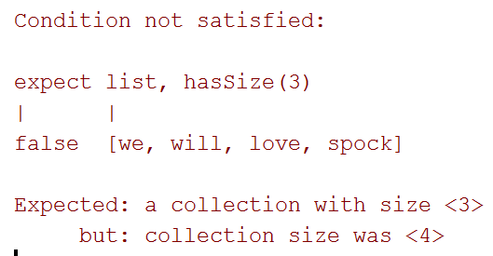
Episode II: Assertions

Slide 37
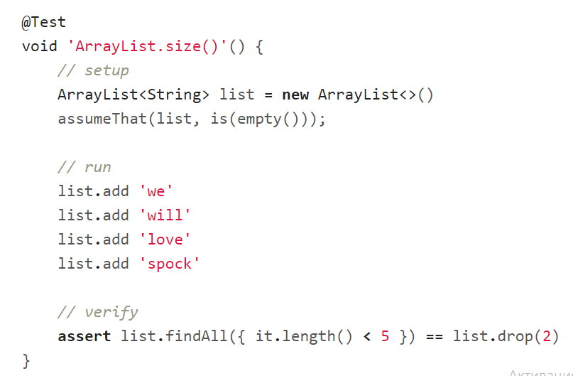
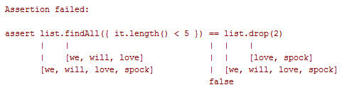
Episode II: Assertions

Slide 38
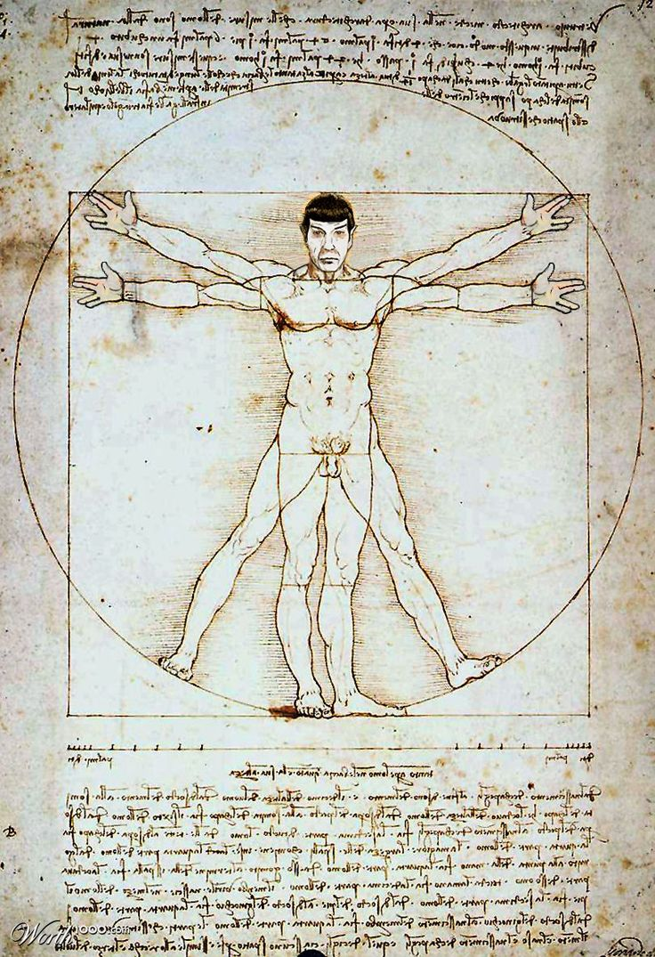
Episode III: Idiomatic Spock

Slide 39
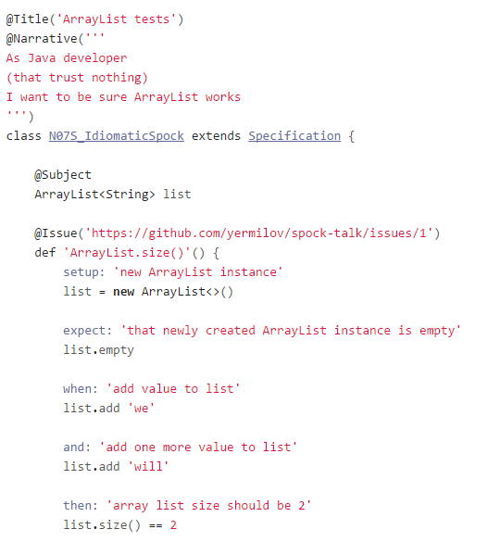
Episode III:
Idiomatic Spock

Slide 40
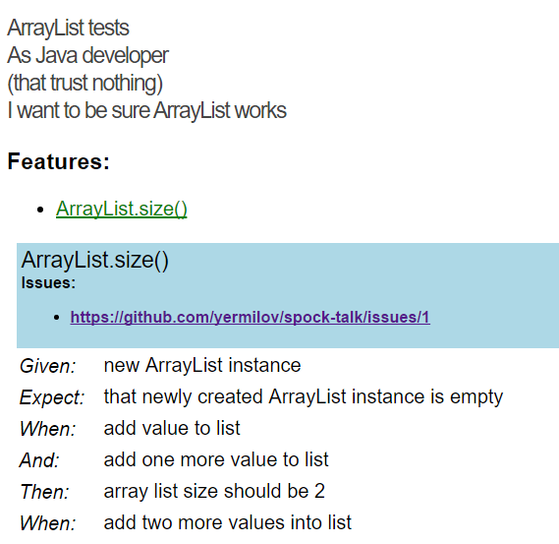
Episode III:
Idiomatic Spock
github.com/renatoathaydes/spock-reports

Slide 41
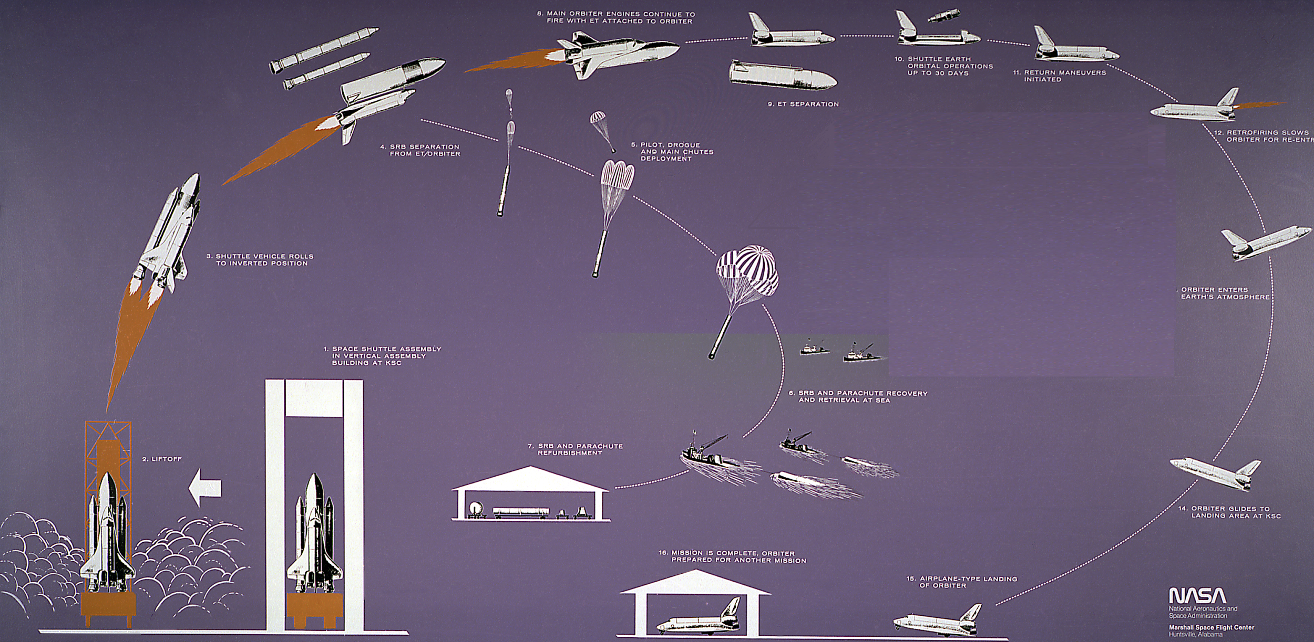
Episode IV:
Setup/Teardown

Slide 42
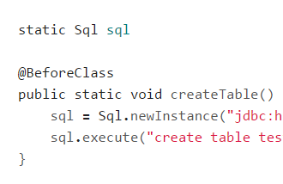
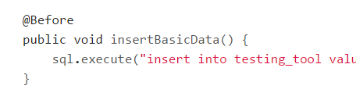
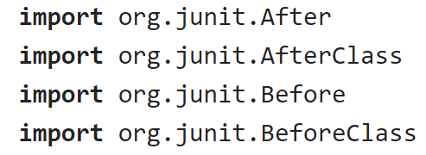
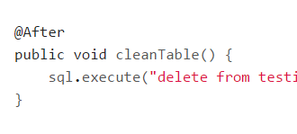
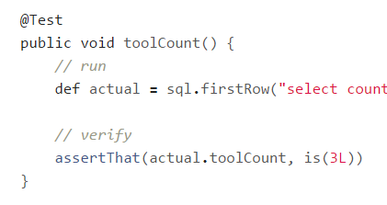
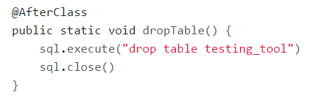
Episode IV: Setup/Teardown

Slide 43
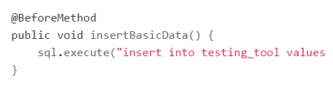
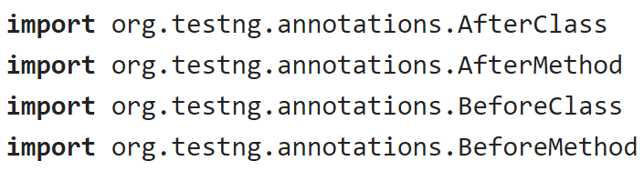
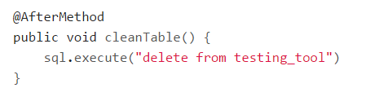
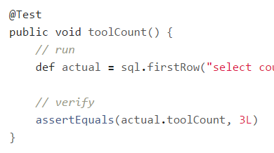
Episode IV: Setup/Teardown

Slide 44
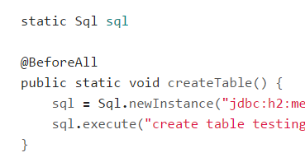
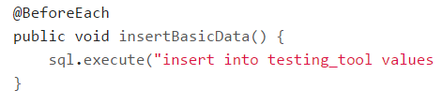
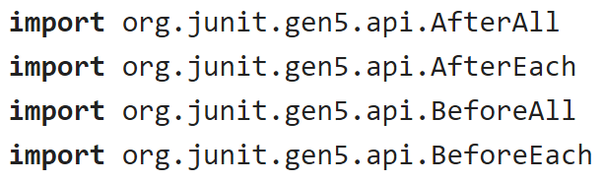
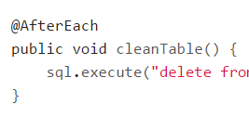


Episode IV: Setup/Teardown

Slide 45





Episode IV: Setup/Teardown

Slide 46


Episode IV: Setup/Teardown

Slide 47

Episode IV: Setup/Teardown

Slide 48


Episode IV: Setup/Teardown

Slide 49





Episode IV: @Shared or static?

Slide 50

Episode V:
Data driven test

Slide 51

Episode V: Data driven test

Slide 52

Episode V: Data driven test

Slide 53

Episode V: Data driven test

Slide 54

Episode V: Data driven test

Slide 55

Episode V: Data driven test

Slide 56

Episode V: Data driven test

Slide 57

Episode V: Data driven test

Slide 58

Episode V: Data driven test

Slide 59

Episode VI:
Exceptions

Slide 60

Episode VI: Exceptions

Slide 61

Episode VI: Exceptions

Slide 62

Episode VI: Exceptions

Slide 63

Episode VI: Exceptions

Slide 64

Episode VI: Exceptions

Slide 65

Episode VI: Exceptions

Slide 66

Episode VI: Exceptions

Slide 67

Episode VI: Exceptions

Slide 68

Episode VI: Exceptions

Slide 69

Episode VII:
Mocks,
Stubs,
Spies

Slide 70


Episode VII: Mocks, Stubs, Spies

Slide 71

Episode VII: Mocks, Stubs, Spies

Slide 72


Episode VII: Mocks, Stubs, Spies

Slide 73

Episode VII: Mocks, Stubs, Spies

Slide 74

Episode VII: Mocks, Stubs, Spies

Slide 75


Episode VII: Mocks, Stubs, Spies

Slide 76

Episode VII: Mocks, Stubs, Spies

Slide 77

Episode VII: Mocks, Stubs, Spies

Slide 78

Episode VII: Mocks, Stubs, Spies

Slide 79

Episode VII: Mocks, Stubs, Spies

Slide 80

Episode VIII: Time travel

Slide 81

Episode VIII: Time travel

Slide 82
Episode VIII: Time travel

Slide 83


Episode VIII: Time travel

Slide 84

Episode VIII: Time travel

Slide 85

Episode VIII: Time travel

Slide 86

Episode VIII: Time travel

Slide 87

Episode VIII: Time travel

Slide 88


Episode VIII: Time travel

Slide 89

Episode VIII: Time travel

Slide 90


Episode VIII: Time travel

Slide 91

Episode IX:
Test control

Slide 92



Episode IX: Test control

Slide 93

Episode IX: Test control

Slide 94
Episode IX: Test control

Slide 95

Episode IX: Test control

Slide 96

Episode IX: Test control

Slide 97

Episode IX: Test control

Slide 98

Episode IX: Test control

Slide 99

Episode IX: Test control

Slide 100

Episode IX: Test control

Slide 101


Episode IX: Test control

Slide 102

Episode IX: Test control

Slide 103



Episode IX: Test control

Slide 104

Episode X: Encore

Slide 105

Episode X: Encore

Slide 106

Episode X: Encore

Slide 107

Episode X: Encore

Slide 108

Episode X: Encore

Slide 109

Episode X: Encore

Slide 110

Episode X: Encore

Slide 111

Episode X: Encore

Slide 112

Why one should use Spock?

Slide 113

Concise syntax

Slide 114

Language for testing instead of testing struggling language

Slide 115

Clear test structure

Slide 116

Code and reports readable for everyone

Slide 117

Powerful built-in features

Slide 118

Extensions

Slide 119

Useful for unit, integration and functional tests

Slide 120


Behaves as one more JUnit runner

Slide 121

Works for both Groovy and Java

Slide 122

Why one should not use Spock?

Slide 123

JUnit/TestNG has 90% similar/imitable features

Slide 124



Spock lost its lead developer

Slide 125

When one can use Spock?

Slide 126

Your team is ready to make one step forward

Slide 127

You are about to start new project

Slide 128

You want to cover legacy project with unit tests

Slide 129

You want to introduce functional testing in your project

Slide 130
What’s next?
Spock documentation
Spock source repositories
Spock examples project
Spock smoke tests
Spock Web Console
Spock reports

Slide 131
What’s next?
mrhaki about Spock
Spock vs JUnit by Kostis Kapelonis and Athens Greece
Smarter testing Java code with Spock Framework by Marcin Zajączkowski
Idiomatic Spock by Rob Fletcher
Spock: A Logical Framework for Enterprise Testing by Ken Kousen

Slide 132
What’s next?
Java Testing with Spock by Konstantinos Kapelonis
Geb documentation
Geb for browser automation by Jacob Aae Mikkelsen
https://twitter.com/yermilov17
https://www.facebook.com/yaroslav.yermilov
https://ua.linkedin.com/pub/yaroslav-yermilov/58/682/506

Slide 133

Thanks!

